Slide 1


1cm² Sensor Designs
Caleb Fink (UC Berkeley)
Pyle Group, SPICE Collaboration

Slide 2
Outline
QET Design Considerations
How does Energy resolution scale with Tc and Al Surface Coverage
Optimization of low coverage QET devices
4,1,0.25
Detector mask designs

Slide 3
Low Coverage Design Considerations
The following arguments are using toy models for illustrative purposes

Slide 4
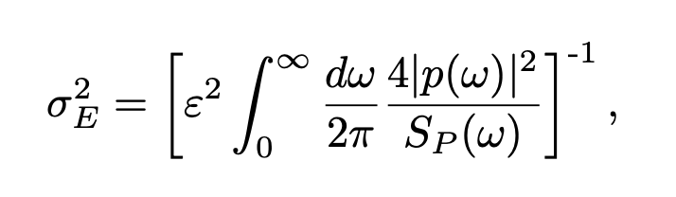
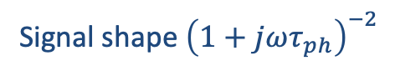
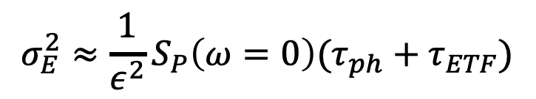
Goal: Energy Sensitivity
The absolute most important design driver is energy sensitivity!
Signal shape ${\left(1+jωτ_{ph}\right)}^{−2}$
Inverse sensor bandwidth
$$σ_{E}^{2}≈{\frac{1}{ε^{2}}S}_{P}\left(ω=0\right)(τ_{ph}+τ_{ETF})$$
Phonon collection time
Total phonon collection efficiency
Power referenced noise spectrum

Slide 5
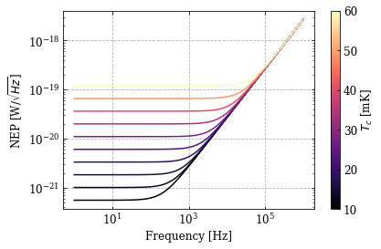
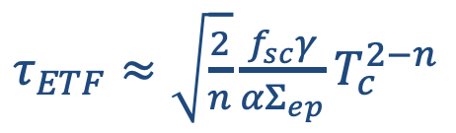
Breaking Down the Noise
Considering only the thermal fluctuation noise between the sensor and the bath (TFN), the power noise (NEP^2) is given by
$$S_{P}\left(ω\right)≈4nk_{B}FΣ_{ep}N_{TES}V_{TES}T_{c}^{n+1}(1+ω^{2}τ_{ETF}^{2})$$
$τ_{ETF}≈\sqrt{\frac{2}{n}}\frac{f_{sc}γ}{αΣ_{ep}}T_{c}^{2−n}$
(ignoring contributions from resistance, etc)
In-band noise decreases faster with Tc than bandwidth

Slide 6
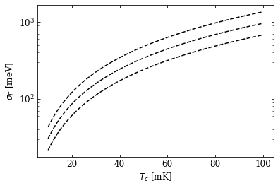
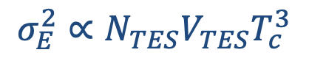
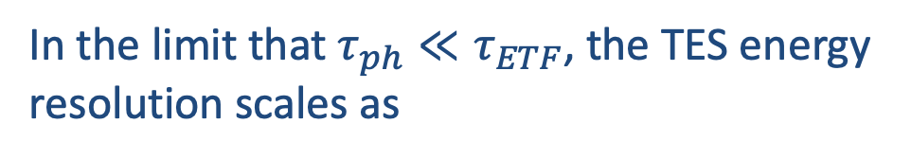
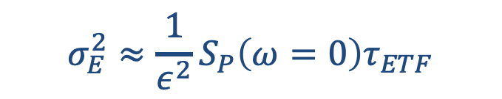
Ignoring the Phonons…
In the limit that $τ_{ph}≪τ_{ETF}$, the TES energy resolution scales as
Increasing number of TES
$$σ_{E}^{2}≈{\frac{1}{ε^{2}}S}_{P}\left(ω=0\right)τ_{ETF}$$
$$σ_{E}^{2}∝{N_{TES}V}_{TES}T_{c}^{3}$$
Decreasing volume/number of TES and Tc has huge benefits

Slide 7
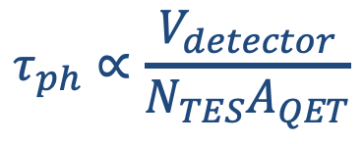
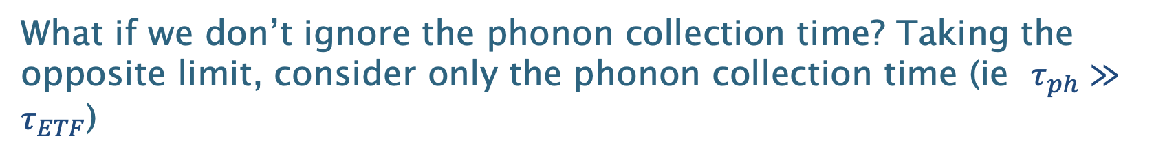
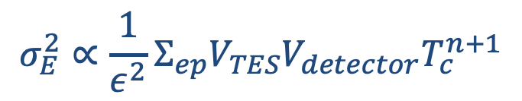
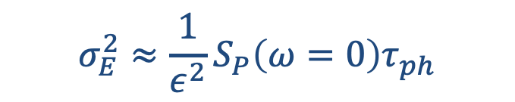
Phonon Collection Time
What if we don’t ignore the phonon collection time? Taking the opposite limit, consider only the phonon collection time (ie $τ_{ph}≫τ_{ETF}$)
$$σ_{E}^{2}≈\frac{1}{ε^{2}}S_{P}\left(ω=0\right)τ_{ph}$$
$$τ_{ph}∝\frac{V_{detector}}{N_{TES}A_{QET}}$$
$$σ_{E}^{2}∝{\frac{1}{ε^{2}}Σ}_{ep}V_{TES}V_{detector}T_{c}^{n+1}$$
In this limit, the Tc dependence is even stronger!
Note: Once we are in this limit, there is no longer a strong dependence on the number of TESs

Slide 8
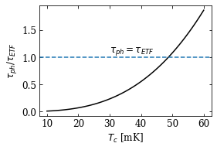
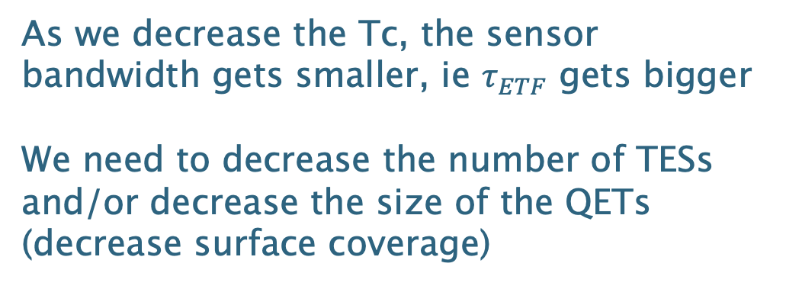
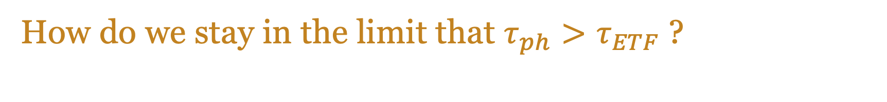
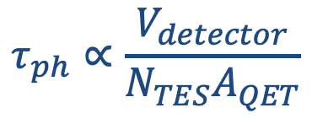
How do we stay in the limit that $τ_{ph}>τ_{ETF}$ ?
As we decrease the Tc, the sensor bandwidth gets smaller, ie $τ_{ETF}$ gets bigger
We need to decrease the number of TESs and/or decrease the size of the QETs (decrease surface coverage)
$$τ_{ph}∝\frac{V_{detector}}{N_{TES}A_{QET}}$$
A good way to think about this: As the sensor slows down by decreasing Tc, you need to give it more time to collect all the phonons

Slide 9
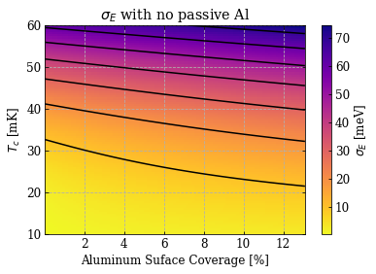
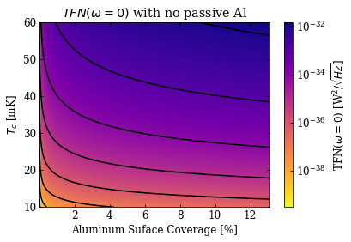
Combining Tc and Surface Coverage
Ignoring the effects of passive Aluminum, the optimum design is always towards lower Tc and lower surface coverage

Slide 10
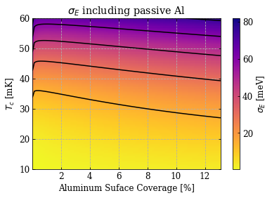
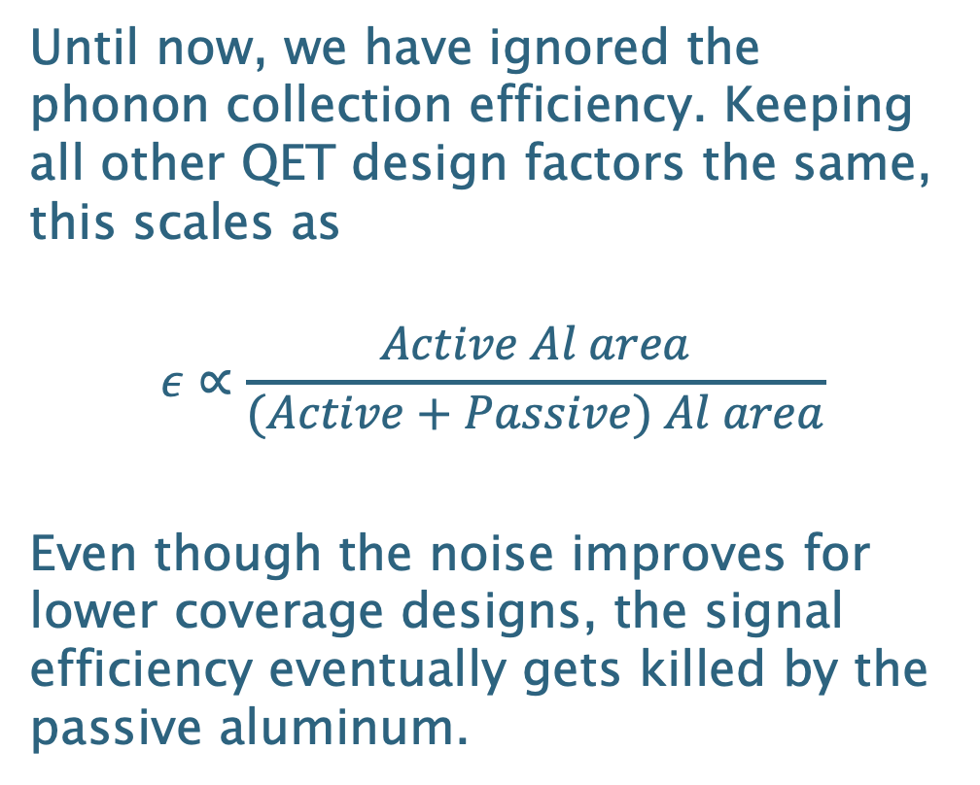
Is Lower Surface Coverage Always Better?
Until now, we have ignored the phonon collection efficiency. Keeping all other QET design factors the same, this scales as
$$ε∝\frac{Active Al area}{(Active+Passive) Al area}$$
Even though the noise improves for lower coverage designs, the signal efficiency eventually gets killed by the passive aluminum.

Slide 11
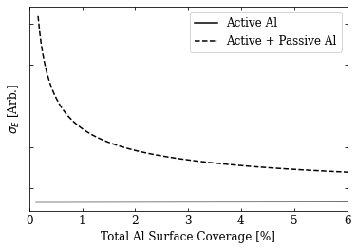
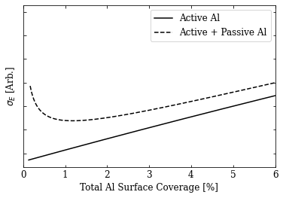
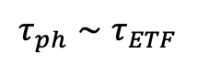
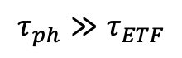
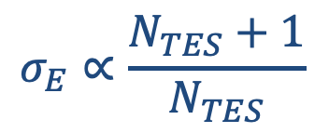

Passive Surface Area
For low coverage devices, the passive Aluminum is VERY important!
For fixed surface coverage: High Tc
For fixed surface coverage: Low Tc
$$τ_{ph}≫τ_{ETF}$$
$$τ_{ph}∼τ_{ETF}$$
$$σ_{E}∝\frac{N_{TES}+1}{N_{TES}}$$
$$σ_{E}∝N_{TES}$$

Slide 12
Where Does the Passive Area Come From?
Contributions to passive area are:
Alignment Marks
Can be placed on different chips since this is fabricated on a full wafer
Bonding pads
Small area ~size of a few QETs
Au thermalization pad
Small area ~size of a few QETs
Bias Rails
Biggest offender!

Slide 13
Close Packed Design
Reduce passive Al by ‘close packing’ the design.
Greatly improve energy resolution
Comes at the cost of introducing position dependance

Slide 14

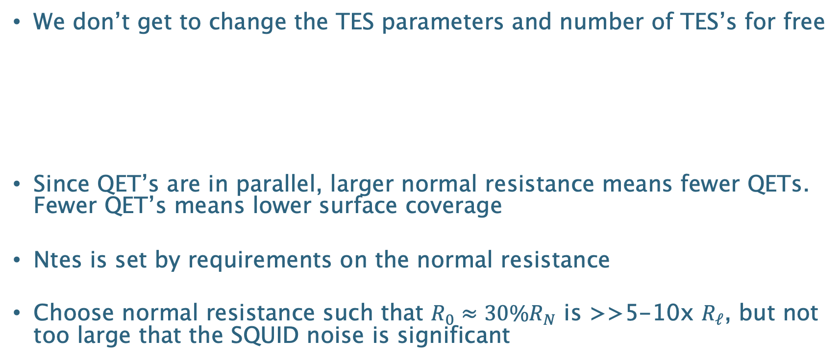
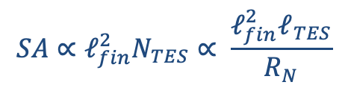
Dependence on Rn
We don’t get to change the TES parameters and number of TES’s for free
Since QET’s are in parallel, larger normal resistance means fewer QETs. Fewer QET’s means lower surface coverage
Ntes is set by requirements on the normal resistance
Choose normal resistance such that $R_{0}≈30\%R_{N}$ is >>5-10x $R_{ℓ}$, but not too large that the SQUID noise is significant
$$N_{TES}=\frac{ρ_{W}}{R_{N}}\frac{ℓ_{TES}}{w_{TES}h_{TES}}$$
$$SA∝ℓ_{fin}^{2}N_{TES}∝ \frac{ℓ_{fin}^{2}ℓ_{TES}}{R_{N}}$$

Slide 15
Wafer Layout - Devices
High coverage device for Dan McKinsey
50% Al coverage
Low coverage devices for SPICE
4%, 1%, 0.25% Al coverage devices for very low energy resolution and to study phonon collection time
Primarily single channel, but a few 2 channel devices for studying thermal conductance(s)
TES/QET test structures
A few chips for noise and QET dynamics studies
Likely very similar to original QP devices

Slide 16
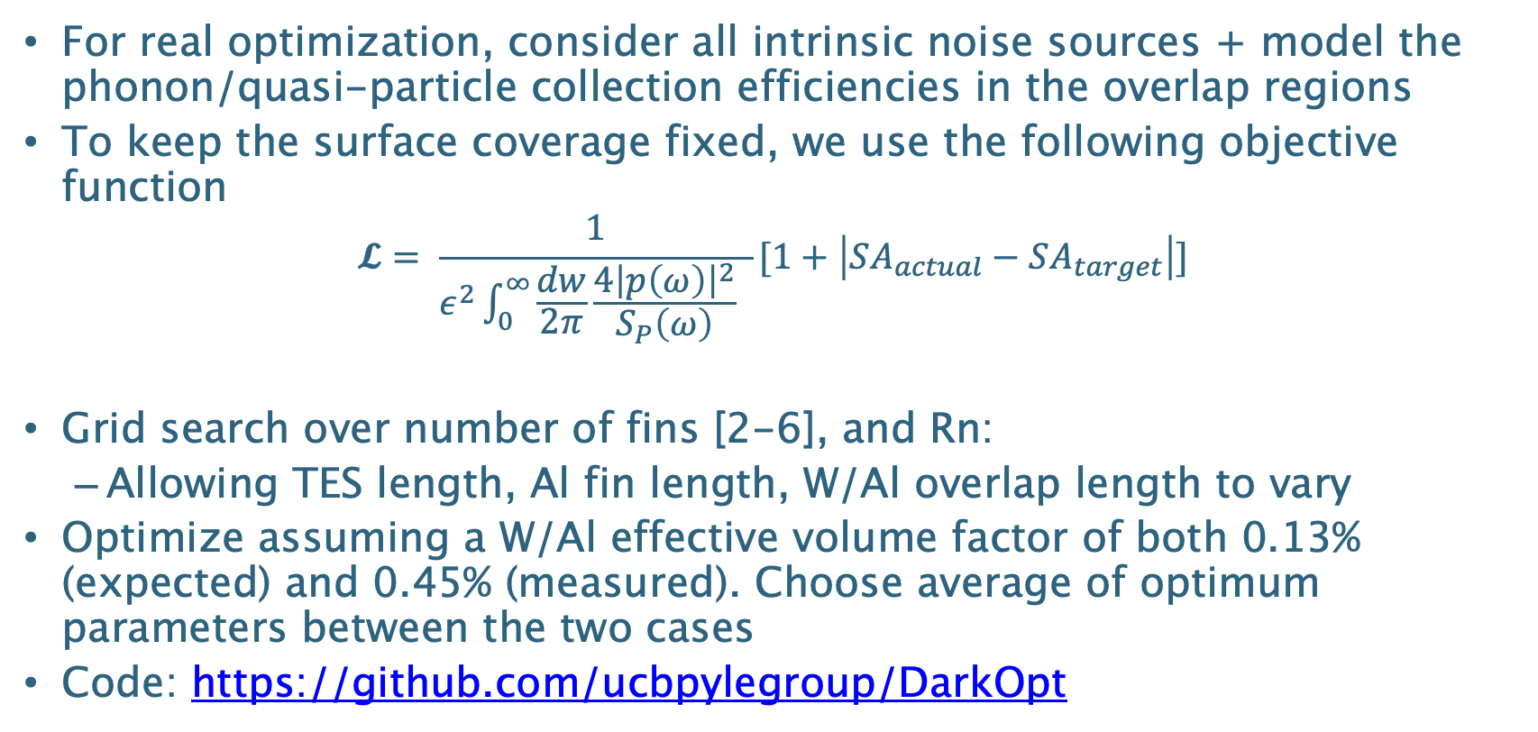
QET Optimization
For real optimization, consider all intrinsic noise sources + model the phonon/quasi-particle collection efficiencies in the overlap regions
To keep the surface coverage fixed, we use the following objective function
$$𝓛= \frac{1}{ε^{2}\int_{0}^{∞}{\frac{dw}{2π}\frac{4{\left|p\left(ω\right)\right|}^{2}}{S_{P}\left(ω\right)} }}[1+\left|SA_{actual}−SA_{target}\right|]$$
Grid search over number of fins [2-6], and Rn:
Allowing TES length, Al fin length, W/Al overlap length to vary
Optimize assuming a W/Al effective volume factor of both 0.13% (expected) and 0.45% (measured). Choose average of optimum parameters between the two cases
Code: https://github.com/ucbpylegroup/DarkOpt

Slide 17

Low Coverage Devices
The SPICE MELANGE detectors:
(M)illi (E)electronVolt sensor with (L)ow (A)luminum coverage for (N)uclear (G)enerated (E)xcitations

Slide 18
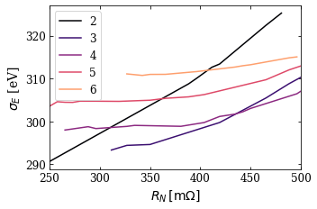
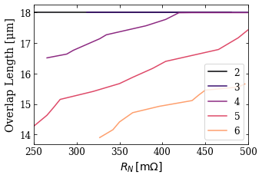
4% Coverage Device
Smaller number of fins forces the overlap region to be large. We don’t yet have a good understanding of large overlap lengths. We should exclude the 2 and 3 fin designs for this device
Optimize for normal resistance
Keep surface coverage fixed and optimize free QET params as a function of Rn
* W/Al effective volume factor = 0.45
Choose Rn around 300-350, and 5 fin design

Slide 19
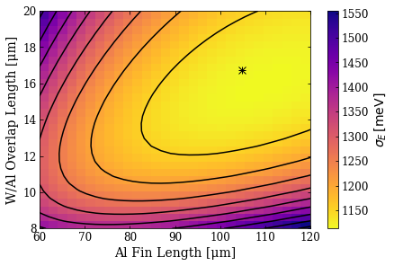
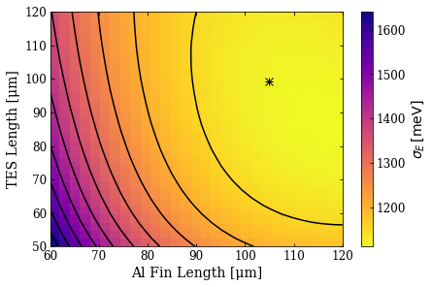
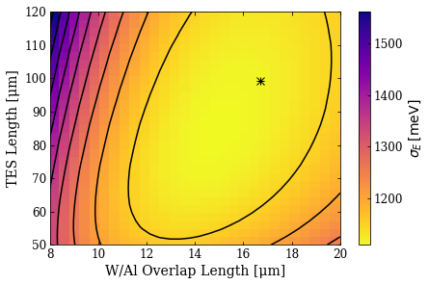
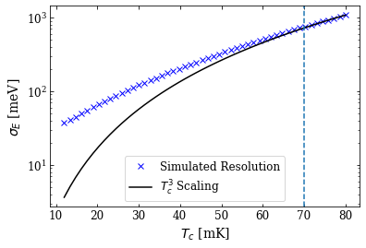
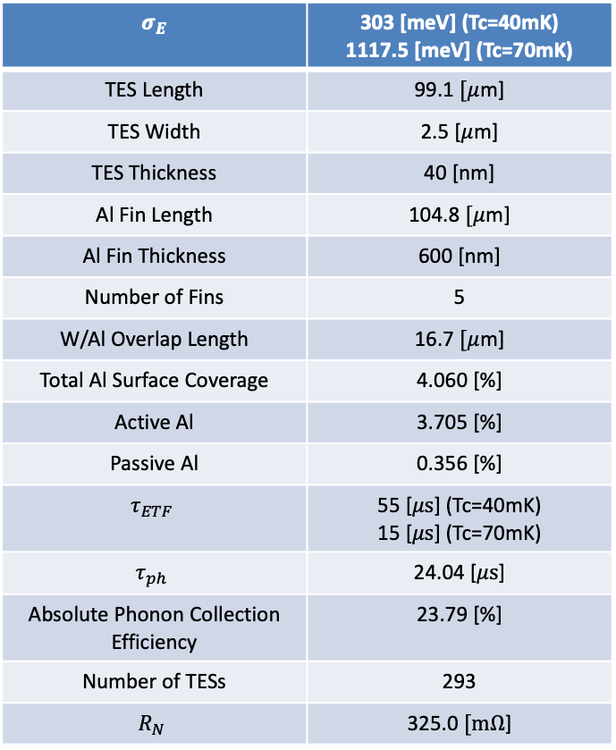
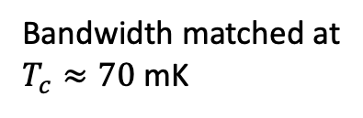
4% Coverage Device
Vary Parameters but fixed Number of TESs (fixed Rn)
Plots shown at bandwidth matched Tc of 70mK
$$σ_{E}$$ | 303 [meV] (Tc=40mK) 1117.5 [meV] (Tc=70mK)
TES Length | 99.1 $[μ$m]
TES Width | 2.5 [$μ$m]
TES Thickness | 40 [nm]
Al Fin Length | 104.8 $[μ$m]
Al Fin Thickness | 600 [nm]
Number of Fins | 5
W/Al Overlap Length | 16.7 $[μ$m]
Total Al Surface Coverage | 4.060 [%]
Active Al | 3.705 [%]
Passive Al | 0.356 [%]
$$τ_{ETF}$$ | 55 [$μs$] (Tc=40mK) 15 [$μs$] (Tc=70mK)
$$τ_{ph}$$ | 24.04 [$μs$]
Absolute Phonon Collection Efficiency | 23.79 [%]
Number of TESs | 293
$$R_{N}$$ | 325.0 $[mΩ$]
Bandwidth matched at
$T_{c}≈70$mK
Note: plots are not always at optimum because the parameters are the average of two different Fin volume efficiencies

Slide 20
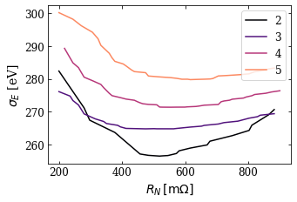
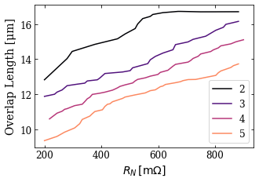
1% Coverage Device
Optimize for normal resistance
Keep surface coverage fixed and optimize free QET params as a function of Rn
Lower coverage device is forcing us to raise the normal resistance of the device
* W/Al effective volume factor = 0.45
Choose Rn around 500-600, and 2 or 3 fin design

Slide 21
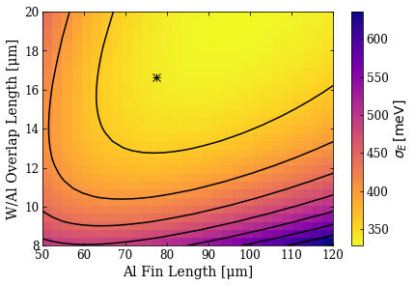
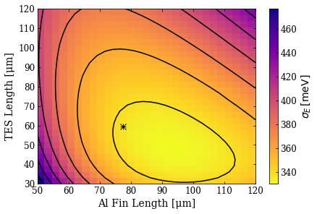
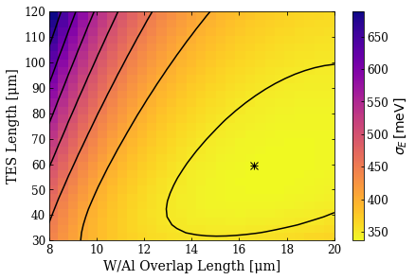
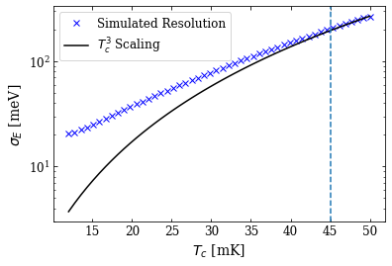
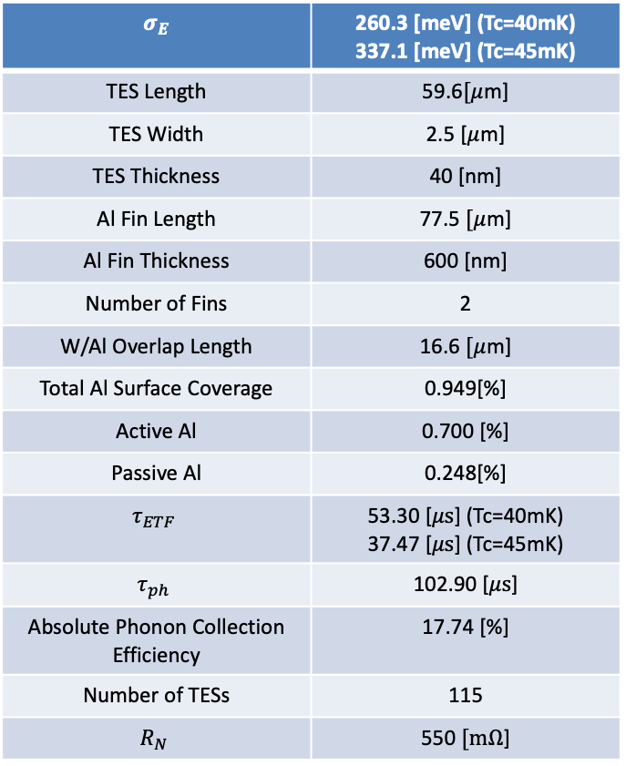
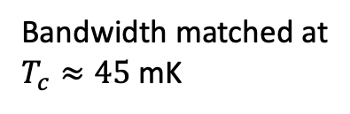
1% Coverage Device (2 Fin)
Vary Parameters but fixed Number of TESs
Plots shown at bandwidth matched Tc of 45mK
$$σ_{E}$$ | 260.3 [meV] (Tc=40mK) 337.1 [meV] (Tc=45mK)
TES Length | 59.6$[μ$m]
TES Width | 2.5 [$μ$m]
TES Thickness | 40 [nm]
Al Fin Length | 77.5 $[μ$m]
Al Fin Thickness | 600 [nm]
Number of Fins | 2
W/Al Overlap Length | 16.6 $[μ$m]
Total Al Surface Coverage | 0.949[%]
Active Al | 0.700 [%]
Passive Al | 0.248[%]
$$τ_{ETF}$$ | 53.30 [$μs$] (Tc=40mK) 37.47 [$μs$] (Tc=45mK)
$$τ_{ph}$$ | 102.90 [$μs$]
Absolute Phonon Collection Efficiency | 17.74 [%]
Number of TESs | 115
$$R_{N}$$ | 550 $[mΩ$]
Bandwidth matched at
$T_{c}≈45$mK
Note: plots are not always at optimum because the parameters are the average of two different Fin volume efficiencies

Slide 22
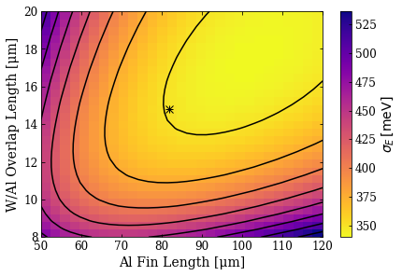
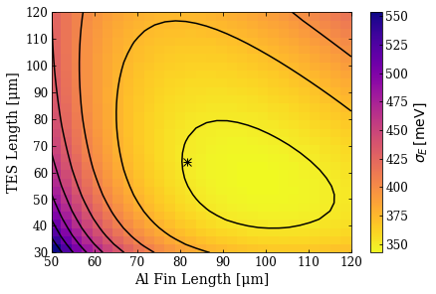
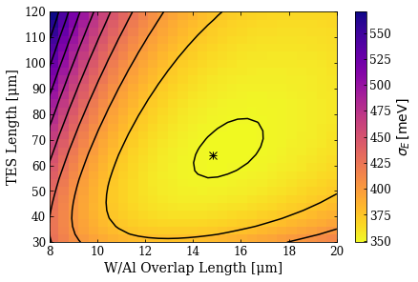
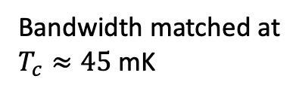
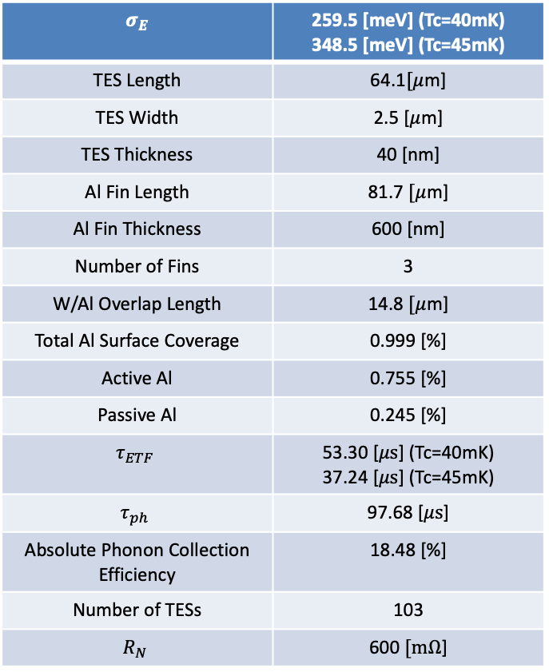
1% Coverage Device (3 Fin)
Vary Parameters but fixed Number of TESs
Plots shown at bandwidth matched Tc of 45mK
$$σ_{E}$$ | 259.5 [meV] (Tc=40mK) 348.5 [meV] (Tc=45mK)
TES Length | 64.1$[μ$m]
TES Width | 2.5 [$μ$m]
TES Thickness | 40 [nm]
Al Fin Length | 81.7 $[μ$m]
Al Fin Thickness | 600 [nm]
Number of Fins | 3
W/Al Overlap Length | 14.8 $[μ$m]
Total Al Surface Coverage | 0.999 [%]
Active Al | 0.755 [%]
Passive Al | 0.245 [%]
$$τ_{ETF}$$ | 53.30 [$μs$] (Tc=40mK) 37.24 [$μs$] (Tc=45mK)
$$τ_{ph}$$ | 97.68 [$μs$]
Absolute Phonon Collection Efficiency | 18.48 [%]
Number of TESs | 103
$$R_{N}$$ | 600 $[mΩ$]
Bandwidth matched at
$T_{c}≈45$mK
Note: plots are not always at optimum because the parameters are the average of two different Fin volume efficiencies

Slide 23


1% Coverage Device (Close Packed)
Optimize for normal resistance
Keep surface coverage fixed and optimize free QET params as a function of Rn
By not equally spacing the QETs, we no longer need to increase the Rn of the device
* W/Al effective volume factor = 0.45
Choose Rn around 300, and 2 or 3 fin design

Slide 24




1% Coverage Device (2 Fin Close Packed)
Vary Parameters but fixed Number of TESs
$$σ_{E}$$ | 216.0 [meV] (Tc=40mK) 292.0 [meV] (Tc=45mK)
TES Length | 58.9$[μ$m]
TES Width | 2.5 [$μ$m]
TES Thickness | 40 [nm]
Al Fin Length | 68.9 $[μ$m]
Al Fin Thickness | 600 [nm]
Number of Fins | 2
W/Al Overlap Length | 16.6 $[μ$m]
Total Al Surface Coverage | 0.999[%]
Active Al | 0.949 [%]
Passive Al | 0.049[%]
$$τ_{ETF}$$ | 53.30 [$μs$] (Tc=40mK) 38.55 [$μs$] (Tc=45mK)
$$τ_{ph}$$ | 97.73 [$μs$]
Absolute Phonon Collection Efficiency | 25.02 [%]
Number of TESs | 177
$$R_{N}$$ | 325 $[mΩ$]
Bandwidth matched at
$T_{c}≈45$mK
Note: plots are not always at optimum because the parameters are the average of two different Fin volume efficiencies

Slide 25




1% Coverage Device (3 Fin Close Packed)
Vary Parameters but fixed Number of TESs
$$σ_{E}$$ | 223.3 [meV] (Tc=40mK) 301.9 [meV] (Tc=45mK)
TES Length | 58.5$[μ$m]
TES Width | 2.5 [$μ$m]
TES Thickness | 40 [nm]
Al Fin Length | 60.6 $[μ$m]
Al Fin Thickness | 600 [nm]
Number of Fins | 3
W/Al Overlap Length | 14.4 $[μ$m]
Total Al Surface Coverage | 1.008 [%]
Active Al | 0.958 [%]
Passive Al | 0.050 [%]
$$τ_{ETF}$$ | 53.30 [$μs$] (Tc=40mK) 38.55 [$μs$] (Tc=45mK)
$$τ_{ph}$$ | 96.82 [$μs$]
Absolute Phonon Collection Efficiency | 25.52 [%]
Number of TESs | 176
$$R_{N}$$ | 320 $[mΩ$]
Bandwidth matched at
$T_{c}≈45$mK
The optimum is trying to push towards a shorter TES, suggesting that the 2 fin is maybe a better design
Note: plots are not always at optimum because the parameters are the average of two different Fin volume efficiencies

Slide 26


0.25% Coverage Device (Close Packed)
Optimize for normal resistance
Keep surface coverage fixed and optimize free QET params as a function of Rn
Given the results of the 1%, we only consider close packed QETs for the 0.25% device
* W/Al effective volume factor = 0.45
Choose Rn around 450, and 2 fin design

Slide 27






0.25% Coverage Device (Close Packed)
Vary Parameters but fixed Number of TESs
$$σ_{E}$$ | 90.3 [meV] (Tc=35mK) 130 [meV] (Tc=40mK)
TES Length | 23.9$[μ$m]
TES Width | 2.5 [$μ$m]
TES Thickness | 40 [nm]
Al Fin Length | 70.6 $[μ$m]
Al Fin Thickness | 600 [nm]
Number of Fins | 2
W/Al Overlap Length | 14.4 $[μ$m]
Total Al Surface Coverage | 0.253[%]
Active Al | 0.239 [%]
Passive Al | 0.015[%]
$$τ_{ETF}$$ | 80.74 [$μs$] (Tc=35mK) 53.88 [$μs$] (Tc=40mK)
$$τ_{ph}$$ | 385.60 [$μs$]
Absolute Phonon Collection Efficiency | 21.08 [%]
Number of TESs | 51
$$R_{N}$$ | 450 $[mΩ$]
Bandwidth matched at
$T_{c}≈35$mK
Note: plots are not always at optimum because the parameters are the average of two different Fin volume efficiencies

Slide 28


Do the Devices Scale As Expected?
Yes!
Considering the bandwidth matched designs, we see that the expected resolution follows:
$$σ_{E}∝T_{c}^{3}$$

Slide 29
Device Design Masks

Slide 30


4% Device - QET
2 um ‘buffer’ of Al to allow for alignment errors
5 Equal area fins
Holes to reduce SC eddy currents
Tapered ‘neck’ from Overlap region to help reduce current QP bottle neck. Also can protect against over etching

Slide 31

4% Device - Layout
293 ‘equally spaced’ QETs
17 rows of distance 564um
13 offset rows with 17 QETs spaced x 544um
4 offset rows with 18 QETs spaced x 515um

Slide 32


1% Device - QET
2 Equal area fins
Tapered ‘neck’ from Overlap region to help reduce current QP bottle neck. Also can protect against over etching
Holes to reduce SC eddy currents

Slide 33

1% Device -QET
Another idea from Scott Hertel
Maximize Overlap region

Slide 34
1% Device – 3 Fin QET
2 fin device has lots of ‘dead space’ in the middle
Try 3 fin design as well
TODO

Slide 35

1% Device – Layout 1
‘Close packed’ design
Limits positional dependence by instrumenting 4 quadrants and the center of the crystal

Slide 36
1% Device – Layout 2
Close packed design in center of chip

Slide 37
1% Device – Layout 3
Other layout ideas?

Slide 38


0.25% Device - QET
2 Equal area fins
Tapered ‘neck’ from Overlap region to help reduce current QP bottle neck. Also can protect against over etching
Holes to reduce SC eddy currents

Slide 39

0.25% Device - Layout
‘Close packed’ design
Instruments one axis of the crystal
Limits positional dependance in this dimension but still will have issues with events on left of right sides

Slide 40
Wafer Layout
Chips will be placed on 4’’ x 4mm (or 1mm) wafer
200um saw width between chips + 2mm safety around edge of wafer
Additionally each chips should have a 200um curb around the inside edge (outer 200um should be non-instrumented)
~50 chips

Slide 41

Idea From Scott for Reducing Passive Al
Move bias rails closer to inner (wider) part of fin

